Slide 1
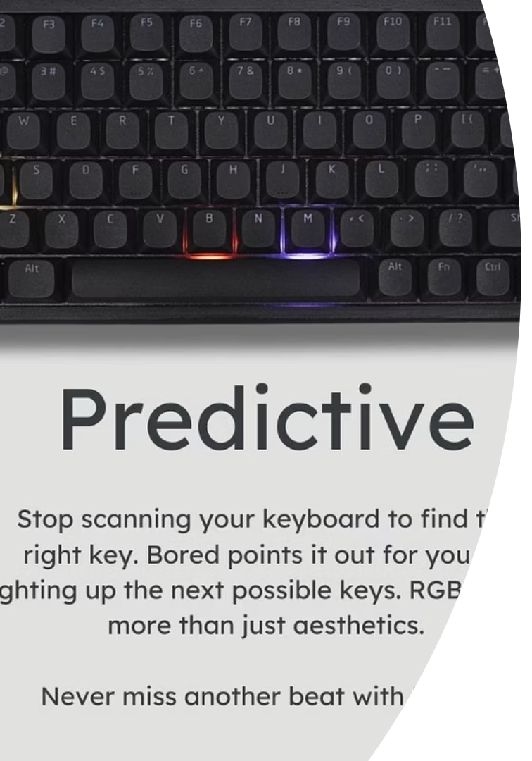
Arabic Autocomplete Using Fine-Tuned AraGPT2
This presentation explores building a fine-tuned Arabic autocomplete model. It addresses challenges in Arabic language processing and presents an open-source next-word prediction tool.

Slide 2
ID
Name
20210065
Ahmed Tarek Abdelwali Ahmed
20210080
Ahmed Alaa Abassi
20210058
Ahmed Said Mohamed Said
20210044
Ahmed Khaled Amin Kady
20210119
Ahmed Medhat Abobakr
20210075
Ahmed Abdelmegid

Slide 3

Problem & Motivation
Lack of Arabic Tools
High-quality autocomplete tools for Arabic are few.
Complexity
Arabic's complex structure and limited datasets complicate modeling.
English Focus
Most NLP models are designed for English.
Project Goal
Create an open-source next-word prediction model for Arabic.

Slide 4
Dataset Used
Source
Size & Split
Preprocessing
OSCAR Corpus (Arabic)
10,000 sentences; 90% train, 10% test
Processed with AraBERT Preprocessor for quality input.
Reasons for Choice
Open-source and easily accessible
High-quality, real-world Arabic text
Suitable for general language modeling and fine-tuning
This dataset was chosen for its scale, accessibility, and diversity in Arabic usage. Although we only used a 10k sample for resource reasons, it provided a strong baseline to fine-tune a transformer on natural Arabic language patterns.

Slide 5

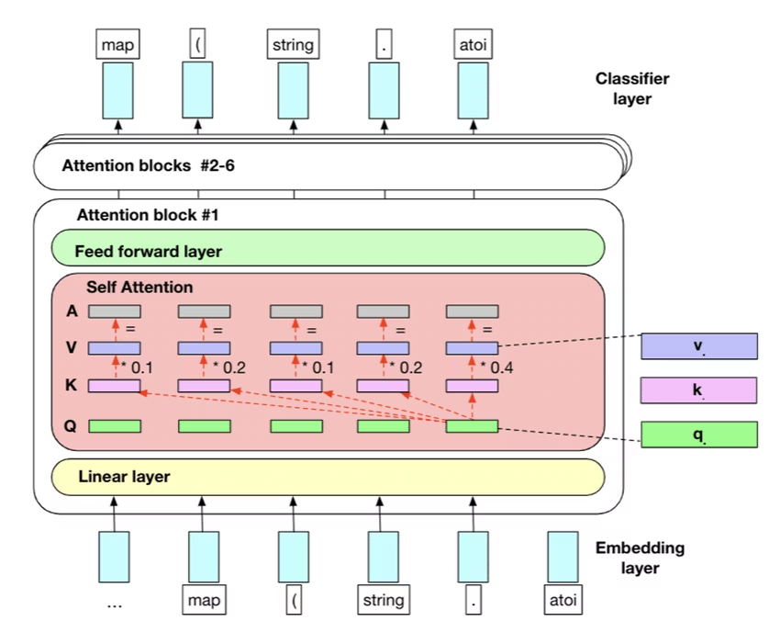
Model Architecture
Model
aubmindlab/aragpt2-base with 125M parameters
Architecture
GPT-2 decoder-only transformer model
Objective
Causal language modeling for next-token prediction
Tokenizer
GPT2TokenizerFast for efficient tokenization

Slide 6
Why We Used GPT-2 for Arabic Autocomplete
Autoregressive Language Modeling
GPT-2 is specifically designed for next-token prediction, making it perfect for autocomplete tasks. It’s a causal (decoder-only) transformer, which:
Takes a sequence as input
Predicts the most likely next word — exactly what autocomplete needs

Slide 7
Feature
RNN / LSTM
GPT-2 (Transformer)
Handles long-term context
Poor (vanishing gradients)
Excellent
Training time
Slow
Fast with parallelism
Quality of predictions
Lower
Higher fluency and relevance
Scalability
Limited
Scales to billions of parameters

Slide 8
We didn't use raw GPT-2 — we used AraGPT2, a model pretrained on Arabic text. This gave us:
Arabic vocabulary support
Arabic sentence structure understanding
Strong pretrained base even before fine-tuning

Slide 9

Model Parameters
Hidden size
768
Number of layers
12
Attention heads per layer
12
Max position embeddings
1024
Total parameters
124 million parameters

Slide 10

Training Parameters
Epochs
1
Batch Size
16
Block Size
64 tokens
Learning Rate
0.00005
Steps
500
Hardware
Google Colab with GPU
Dataset
Trained on OSCAR Arabic subset (10k samples)

Slide 11
Evaluation Metrics
Perplexity
BERTScore (F1)
Measured around 340.08, indicating model uncertainty
Approximate score of 0.73 demonstrating semantic quality

Slide 12

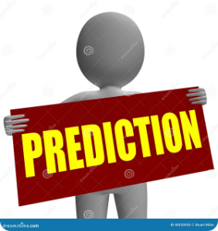


Results & Examples
Prompt: قررت المحكمة
تأجيل
إصدار
بدء
عقد
تنفيذ
Prompt: استعد الرئيس
لإلقاء
للذهاب
لتقديم
للمشاركة
للتحدث

Slide 13
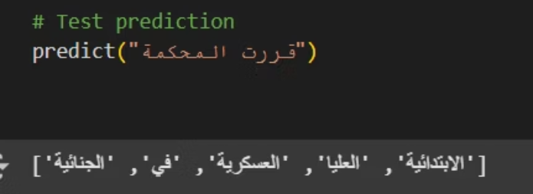
Output Example

Slide 14

Model Deployment
Interface
Model Access
Deployed as an interactive Desktop App
Hosted Locally
User Experience
Users input phrases and get top-5 predicted next words

Slide 15
Limitations & Future Work
Current Limitations
Future Directions
Small dataset limits training scale
Expand training with 100k+ samples
No capability for full sentence continuation
Develop full sentence prediction
Decoding artifacts affect output quality
Improve decoding strategies

Slide 16
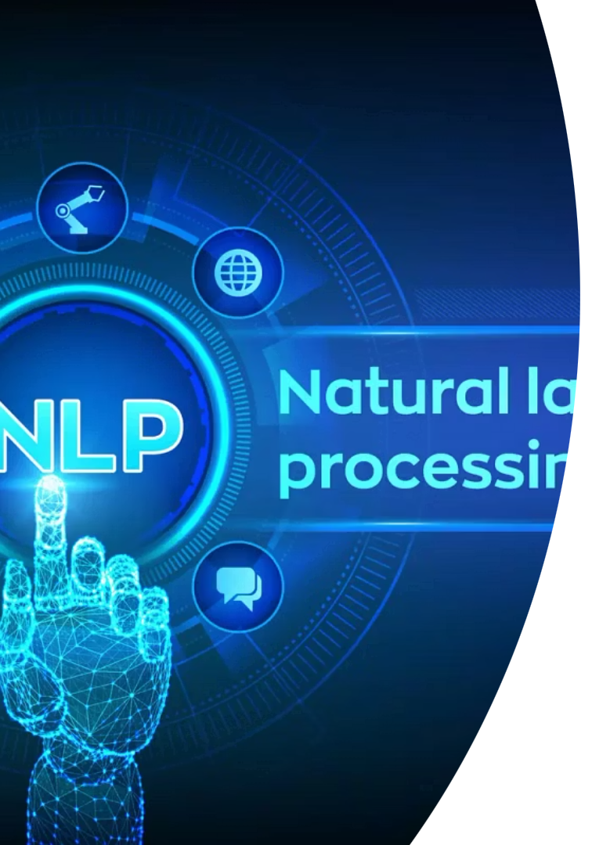
Thank You / Q&A
Appreciation
Questions?
Thank you for your attention and interest.
We welcome your queries and discussion.
Resources
GitHub and Hugging Face links will be provided.

